Slide 1
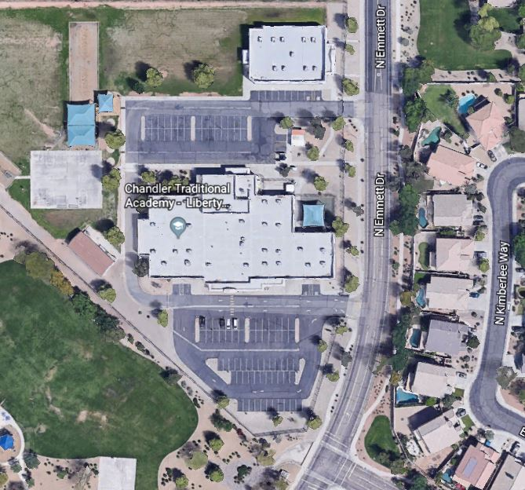
Parent Pick-Up and Drop-Off Students are NOT allowed on campus, including the playground, before 7:45 a.m.
North (Back )Parking Lot: Right Turns Only to Enter Lot.
Left Turns only to Exit Lot.
Drop Off/Pick Up Locations By Grade
North (Back) Parking Lot: K, 3rd, 4th, 5th, 6th Grades
South (Front) Parking Lot: Pre-K, 1st, 2nd Grades
*If you have multiple students, default to the youngest student’s drop off/pick up point.
NORTH STAFF ONLY
1) Please DO NOT park in either lot and then walk up to pick up students, please stay in the pick up line (Exception is Pre-K). 2) Please DO NOT block any crosswalks or handicap stalls. 3) Please DO NOT use cell phones while waiting in line or driving through the parking lots. 4) Students must exit on the curbside only.
SOUTH
South (Front) Parking Lot: Left Turns Only to Enter Lot.
Right Turns only Allowed to Exit Lot.
For student’s safety, NO LEFT turns are allowed into the SOUTH (Front) parking lot to PARK after 2:30 p.m. Please wait in the student pick up line to enter the parking lot.

